Slide 1

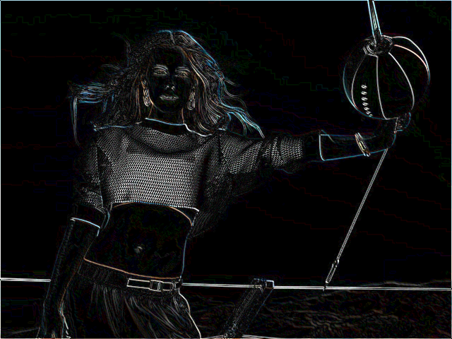

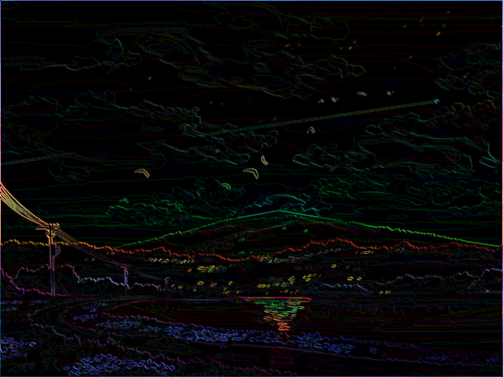
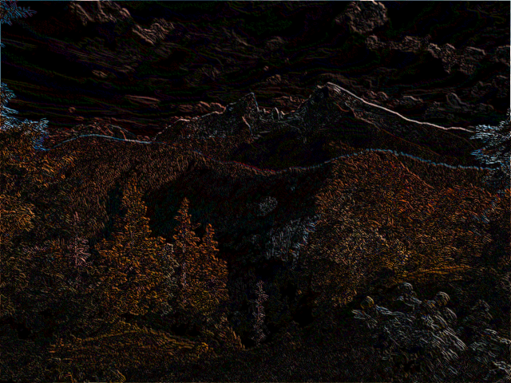




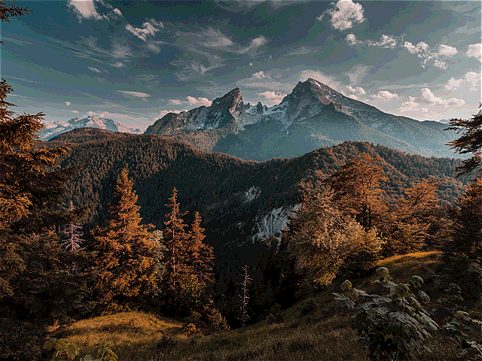

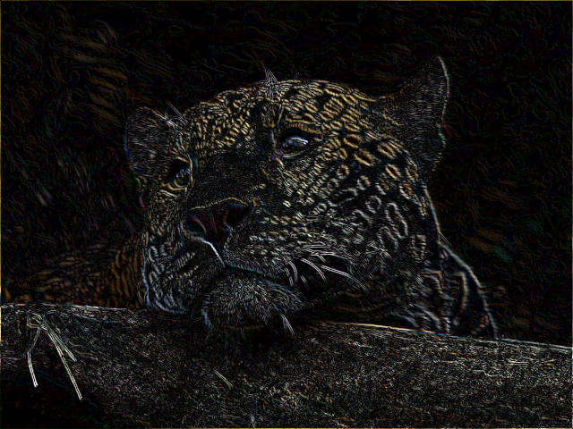
Multi-Purpose Digital Video Processor
Those Squirrely Undergrads
Giacomo Coraluppi
William Krska
Mitch Gilmore
Notes:
will

Slide 2
Goal and Motivation
Data/energy savings
Many applications need segmented or outlined images, but not the raw video feed
Removes a step normally done on general-purpose processor
Privacy and security
Processing the video feed in hardware necessarily does not send all video data to internet enabled device
Sensitive information (faces, background, etc) can be permanently erased near instant after capture
Vehicle detection
Self driving cars depend on the ability to rapidly and automatically detect other vehicles on the road
Edge detection helps reduce the complexity of images that self-driving cars need to analyze while preserving recognizable shapes of other vehicles
Notes:
Giacomo

Slide 3

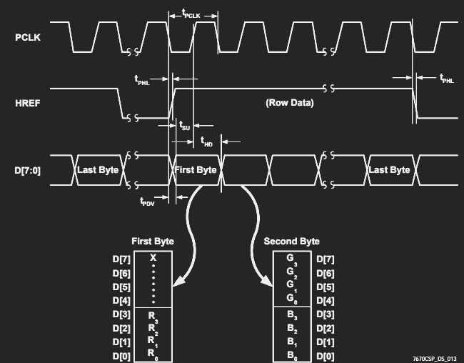
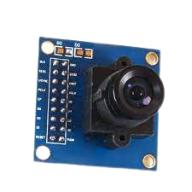
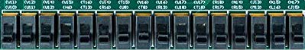
High-Level Functionality
FPGA
Full Frame Buffer RAM
(640 x 480 x 12bit)
VGA
Controller
Config ROM
Kernel ROM
I2C Controller
ALU
I2C
Conv Buffer
8
12
Stream Arbiter
Partial Frame Buffer RAM
(640 x 9 x 12bit)
OV7670
RGB 444
data
Notes:
Mitch

Slide 4
Specification/Requirements
Image processing on live video feed coming from OV7670 camera
Operate at full 60 Hz
Ability to select desired image processing output mode using toggle switches on FPGA
Displaying filtered image or pass-though image on VGA
Convolution of images to detect edges
Notes:
Giacomo

Slide 5
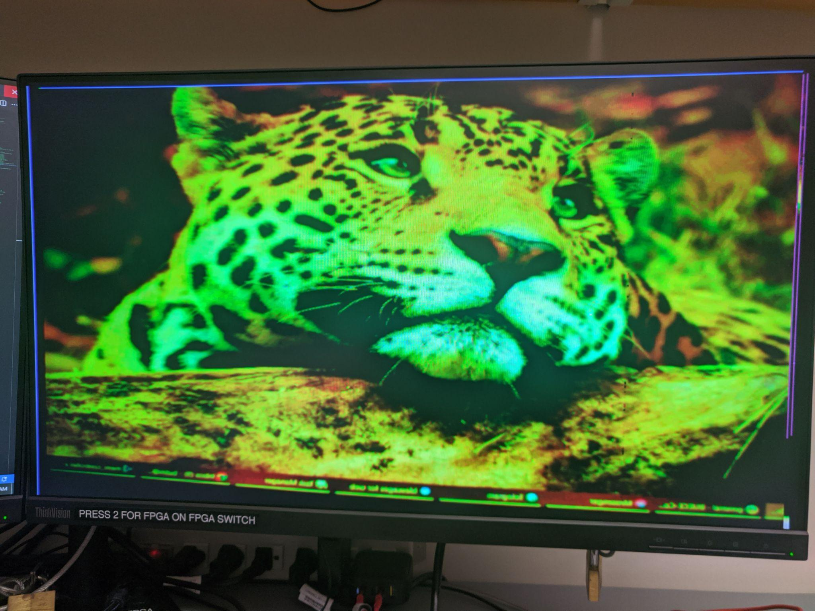
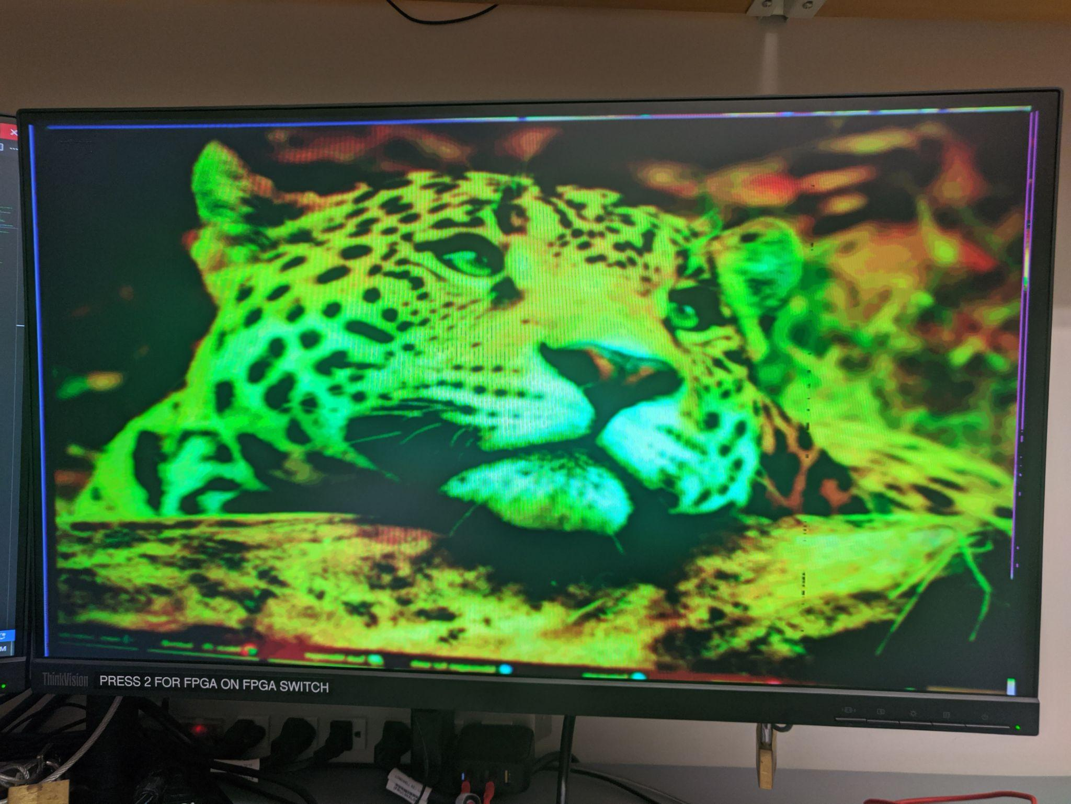
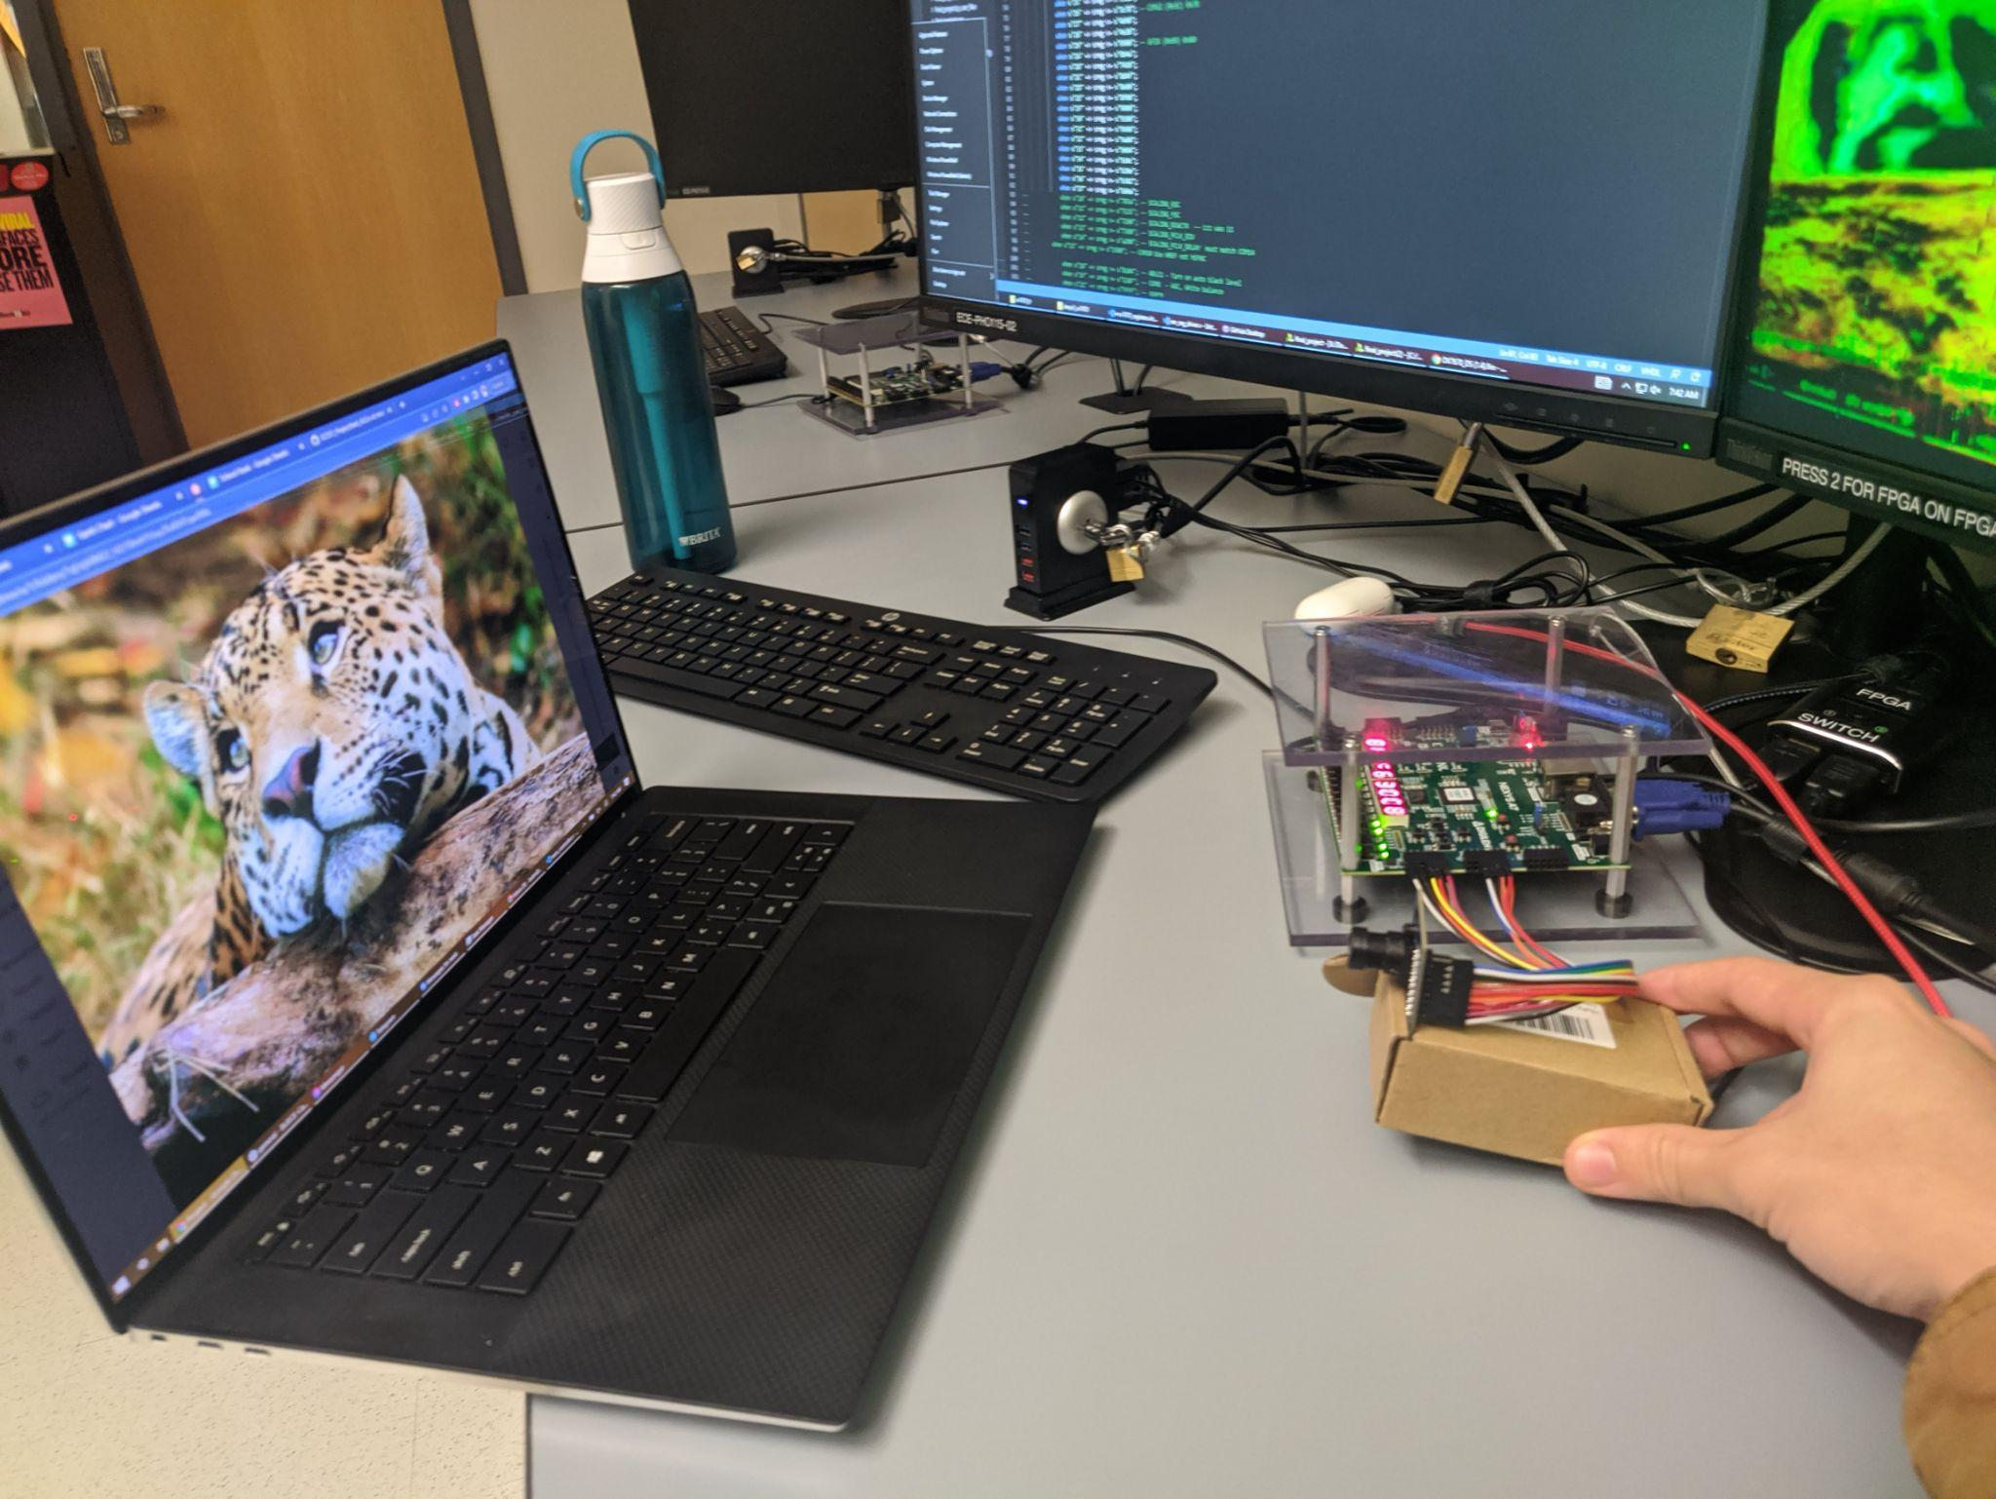
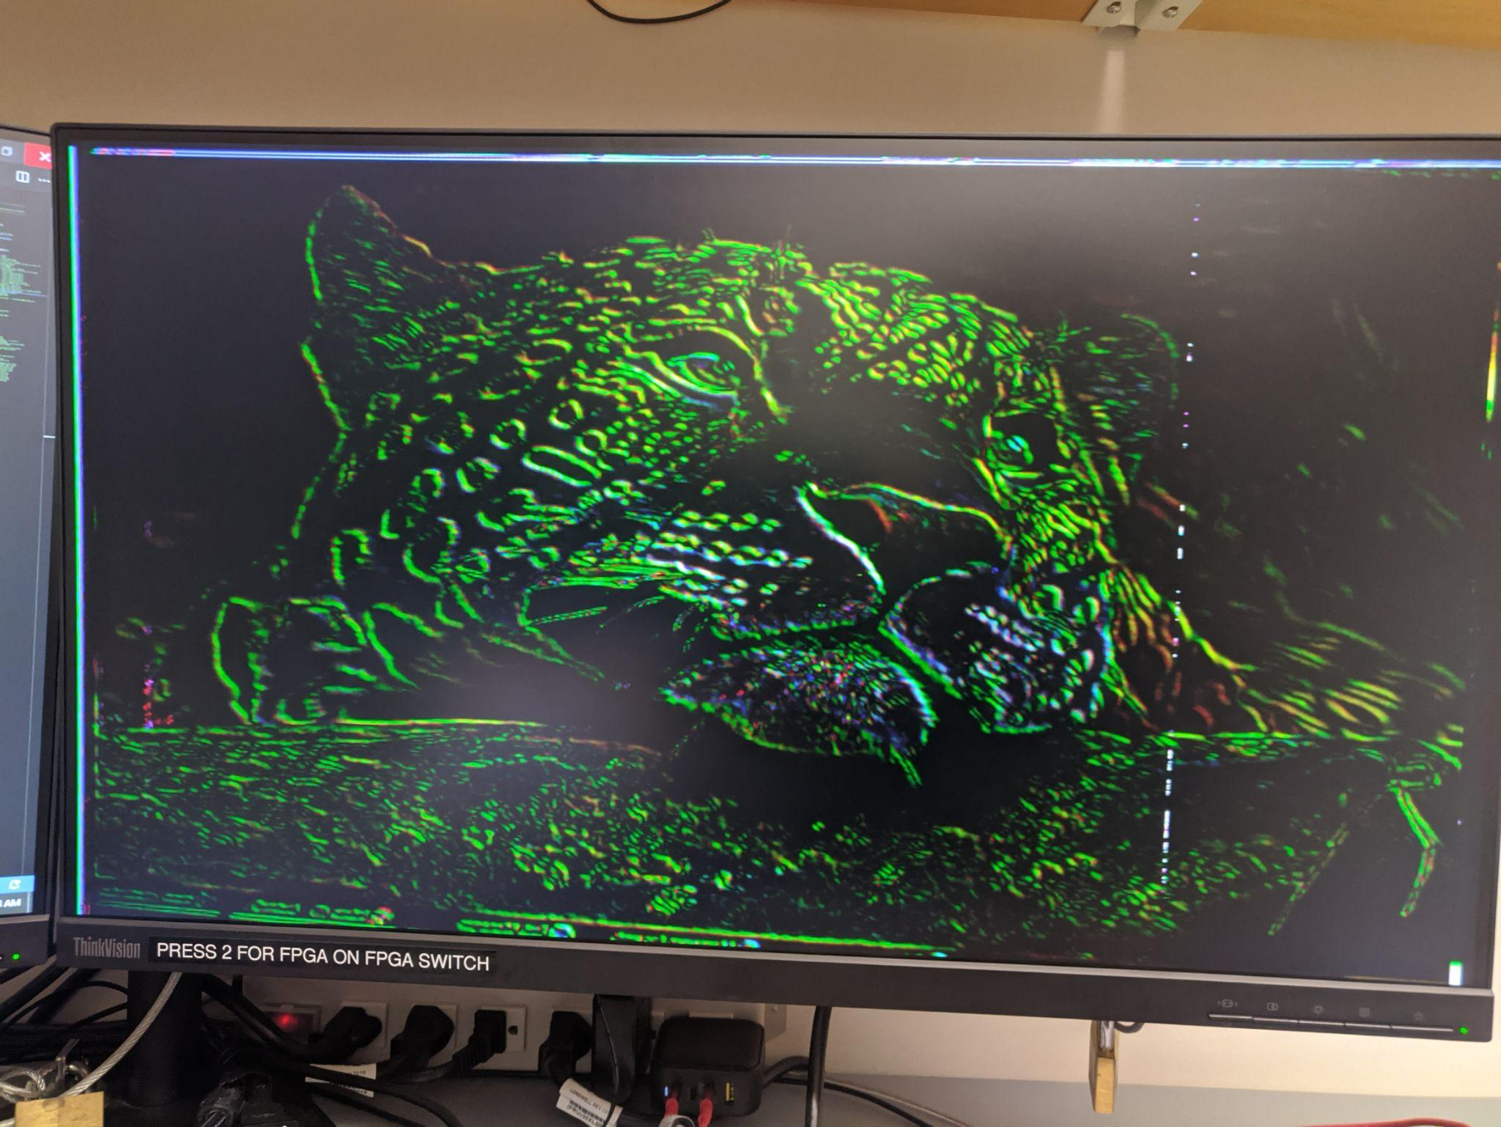
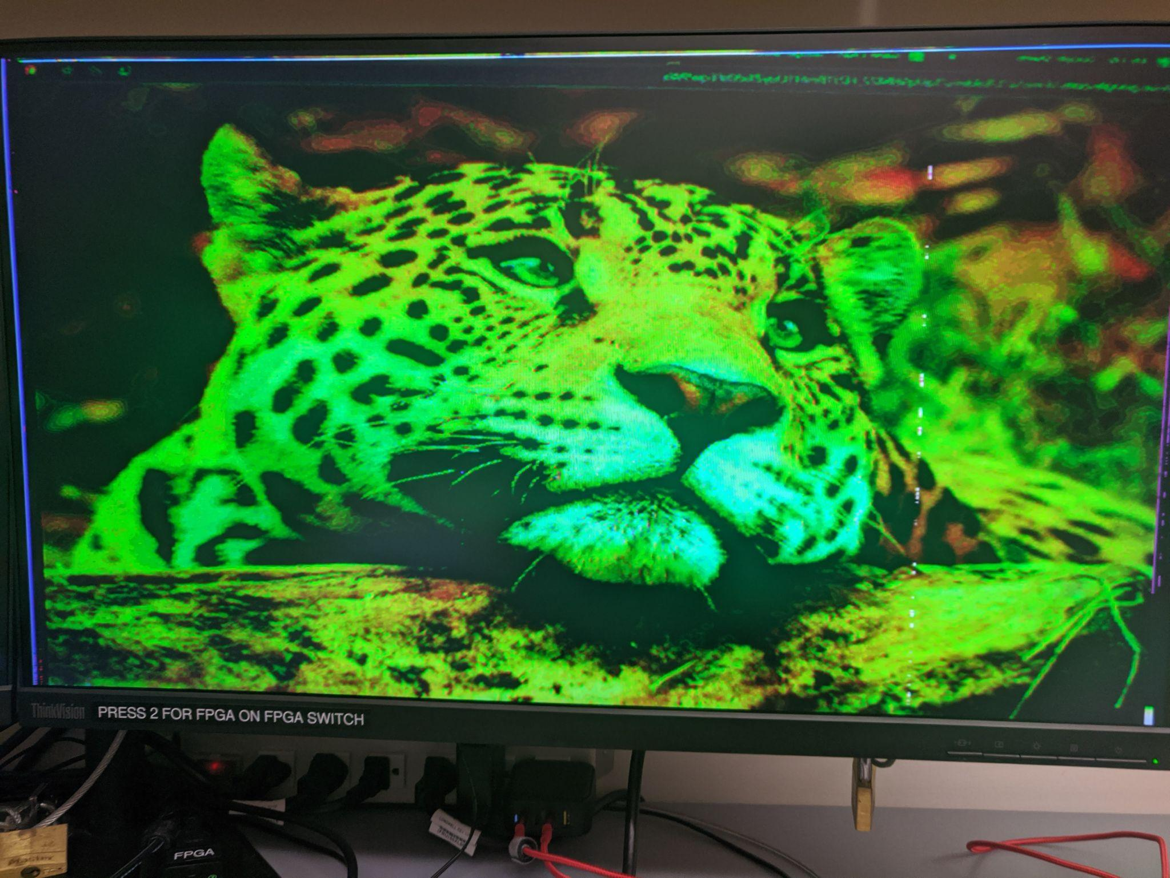
Results Teaser
Passthrough
‘Gaussian’ Blur
Super scientific setup
Edge Detection
Sharpening
Notes:
Mitch

Slide 6
I2C Camera Interface
Camera was configured via its built in I2C interface. Configuration served the following purposes:
Functional configuration:
Configure the camera to output pixels in the RGB444.
The data comes in 2 packets so the camera had to be set to send the data in the xR GB format.
Quality configuration:
Configured various “magic” values based on priors work to improve picture quality from the camera. [3]
Corrected orientation such as flipping the image and rotating it.
Full
VGA
ROM
Kern
I2C
ALU
Conv
Ctrl
Part
Done by: Mitch
Notes:
Mitch

Slide 7
I2C High Level Datapath
1 bit
1 bit
1 bit
1 bit
1 bit
Start
Camera Address
Ack
Register Address
Ack
Register Data
Ack
Stop
8 bits
8 bits
8 bits
Label | Function
Start | Announce the beginning of communication.
Camera Address | Announce which device on the I2C bus who should listen.
Ack | Signal from client device to say it got the data.
Register Address | Register on the device to write to.
Data Register | Data to write to the selected address.
Stop | Signify end of transmission.
Done by: Mitch
Notes:
Mitch

Slide 8
Camera Initialization ASM
Camera Config
Start
Message Index = 0
Camera Boot
Send Message
False
Camera Initialized
True
False
Message Received
True
Message Index += 1
False
More Messages
True
Done
Done by: Mitch
Notes:
Mitch

Slide 9
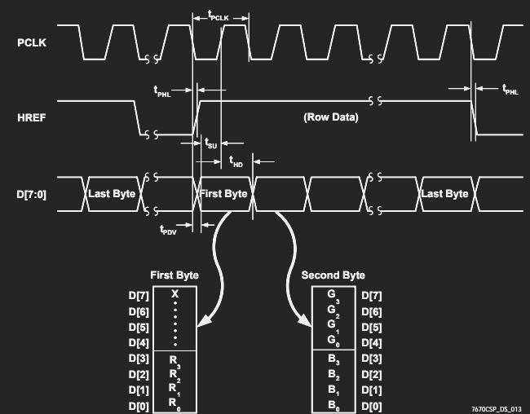
Data Management - Control Logic
Full
VGA
ROM
I2C
ALU
Kern
Conv
vcnt==480
else
Ctrl
Part
hcnt= 0
wen = 0
pop = 0
hcnt++
wen = 0
pop = 0
vsync == 1
else
href == 1
hcnt==640
IDLE
HREF
BYTE0
BYTE1
POP
vcnt= 0
hcnt= 0
wen = 0
pop = 0
hcnt= 0
wen = 0
pop = 0
wen = 1
pop = 0
hcnt++
vcnt++
wen = 0
pop = 0
else
wen = 1
pop = 0
wen = 0
pop = 1
[3:0]
D[3:0] Q
> clk
[7:0] stream_in
D[11:0] Q
> clk
[11:0] d_out
Done by: Will K
Notes:
Will

Slide 10

Data Management - Buffering
Full
VGA
ROM
I2C
ALU
Kern
Conv
Ctrl
Part
[11:0] d_in
wen
pop
…
Slice
D[11:0] Q
wen
rst
> clk
D[11:0] Q
pop
rst
> clk
D[11:0] Q
pop
rst
> clk
D[11:0] Q
pop
rst
> clk
D[11:0] Q
pop
rst
> clk
d_out
Tradeoff of speed vs space
[9:0] hcnt
640 slices
N slices
Partial Frame Buffer
Kernel Buffer
dat_N
Slice
[11:0] d_in
[9:0] hcnt
wen
pop
Slice
[N*12-1:0]
dat_N-1
Slice
[N*N*12-1:0]
d_out
Slice
…
…
640-to-1
wen
dat_1
Slice
Slice
N Lines
N Lines
N Columns
Moving window
Done by: Will K
Notes:
Will

Slide 11
ALU/Kernel Convolution
Full
VGA
ROM
I2C
ALU
Kern
Conv
Ctrl
Part
Example kernel (Blur)
1 4 6 4 1
4 10 18 10 4
6 18 24 18 6
4 10 18 10 4
1 4 6 4 1
D = 8
{R_{(i,j)},G_{(i,j)},B_{(i,j)}}
coef_{i,j}
[11:0] d_in [19:0] d_out
[7:0] coef
Multiply
N²*[19:0]
+
Add
{P_{R(i,j)},P_{G(i,j)},P_{B(i,j)}}
N²
[log₂(N²)+19:0] {S_{R(i,j)},S_{G(i,j)},S_{B(i,j)}}
[22:0] d_in d_out
Absolute Value
>> D
[22:0] d_in d_out
Ceiling
[11:0] d_out
3
3
sum_abs[n] = (sum[N^2-2][0][22]) ?
(~sums[N^2-2][n]+'b1) : sums[N^2-2][n];
d_out[n] = (|sum_abs[n][21:4+D]) ? 4'hf : sum_abs[n][3+D -: 4]
Done by: Will K
Notes:
Will

Slide 12
Display - Frame Buffer and VGA
Full
VGA
ROM
I2C
ALU
Kern
Conv
Ctrl
Part
Multiplexing either between the pass through data from the controller or the ALU output
address = {1'b0,vcnt,9'b0} + {3'b0,vcnt,7'b0} + {10'b0,hcnt};
address = vcnt*512 + vcnt*128 + hcnt // avoids potentially slow 20 bit multiplication
Converted the 12 bit data coming from the VGA into RGB444 to display on the screen
We also had to keep the image within the active pixels by not indexing into the horizontal and vertical front and back porches of the screen
Done by: Giacomo
Notes:
Giacomo

Slide 13
Example: Buffer Slice
[11:0] d_in
wen
pop
`include "my_header.vh"
module buffer_slice(
input wire clk,
input wire rst,
input wire wen,
input wire pop,
input wire [`dwidth_dat-1:0] wdata,
output wire [(`dwidth_dat*`dwidth_slice)-1:0] rdata
);
reg [(`dwidth_dat*(`dwidth_slice+1))-1:0] dat = 'b0;
assign rdata = dat[(`dwidth_dat*(`dwidth_slice+1))-1:`dwidth_dat]; // Homologated memory structure ‘dat’
genvar i;
generate // Generate N (`dwidth_slice) +1 registers
for (i=0; i<(`dwidth_slice+1);i=i+1) begin
if (i==0) begin // Din is assigned to first register given ‘wen’
always @(posedge clk) begin
if (wen)
dat[`dwidth_dat-1:0] <= (rst) ? 'b0 : wdata;
end
end else begin // All other registers assigned to output of previous on ‘pop’
always @(posedge clk) begin
if (pop)
dat[(`dwidth_dat*(i+1))-1 -:`dwidth_dat] <= (rst) ? 'b0 : dat[(`dwidth_dat*i)-1 -:`dwidth_dat];
end
end
end
endgenerate
endmodule
…
Slice
D[11:0] Q
wen
rst
> clk
D[11:0] Q
pop
rst
> clk
D[11:0] Q
pop
rst
> clk
D[11:0] Q
pop
rst
> clk
D[11:0] Q
pop
rst
> clk
d_out
Notes:
Will

Slide 14
Example: Partial Buffer Read Control
assign raddr_alu = {1'b0,vcnt-pad-1,9'b0} + {3'b0,vcnt-pad-1,7'b0} + {10'b0,hcnt};
assign rdata_alu = (rs_c==READ) ? rdata_cbuff : 'b0;
always @(posedge sys_clk) begin
if (rst) rs_c <= 0;
else rs_c <= rs_n;
end
always @(*) begin
case(rs_c)
IDLE : rs_n = (vcnt_c >= pad+1) ? VPAD : IDLE;
VPAD : rs_n = (vcnt_c < `dwidth_slice) ? VPAD : HPAD;
HPAD : begin
if (hcnt_c < pad-1) begin
rs_n = HPAD;
end else if (hcnt_c >= `hwidth-pad-1) begin
if (hcnt_c >= `hwidth-1 && vcnt_c >= `vwidth-1) rs_n = IDLE;
else rs_n = HPAD;
end else begin
rs_n = READ;
end
end
READ: rs_n = (hcnt_c < (`hwidth-pad-1)) ? READ : HPAD;
endcase
end
Full Image
Shown Area
N/2
Notes:
Will

Slide 15
Successes
Configuring camera through I2C controller
Receiving, decoding, and storing data from camera on FPGA
Displaying either filtered or pass-through camera feed on VGA
Parametric Kernel Convolution engine
Easily configurable to accommodate any size (up to ~15) and bit-depth kernel
Edge detection (Sobel) demonstrated
Gaussian blur demonstrated
Sharpening demonstrated
Full resolution image displayed on VGA
User selectable output with toggle switches
Notes:
Mitch

Slide 16
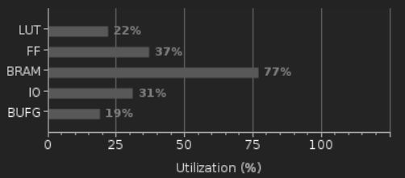
Failures
Not enough time or memory space on FPGA to perform more detailed image processing methods on full image
Reliability Issues: Depending on the FPGA, camera will shut down after variable amount of time, requiring reset.
Believe it is related to a write_enable signal, but behavior is extremely inconsistent
Notes:
Giacomo

Slide 17

Quick Live Demo
github.com/wkrska/EC551_Project

Slide 18
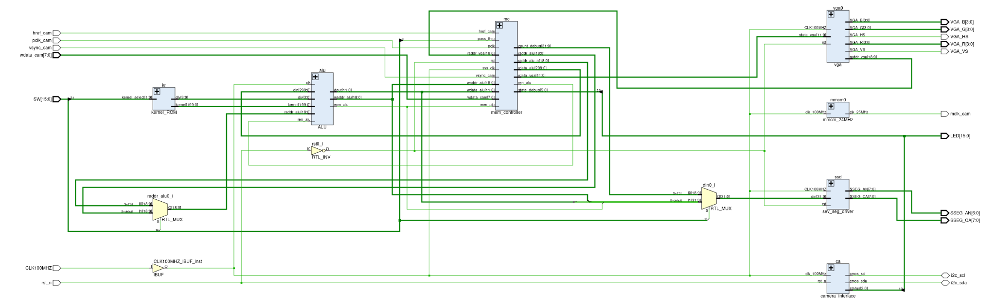
RTL Schematics: top

Slide 19
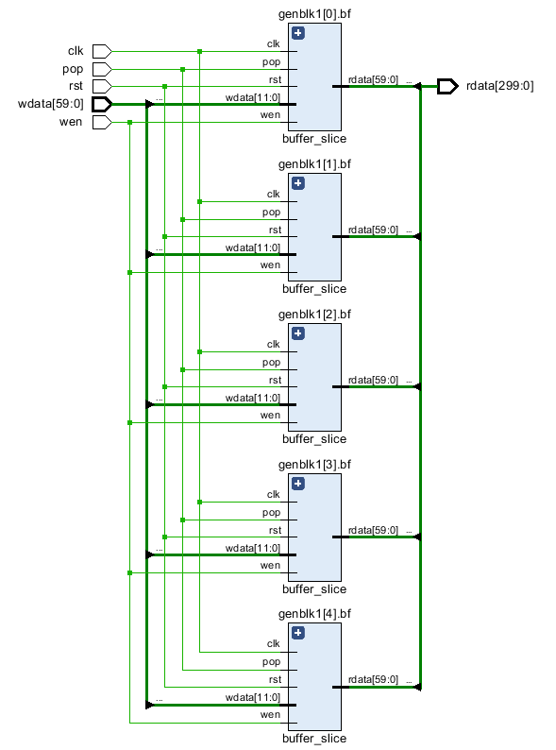
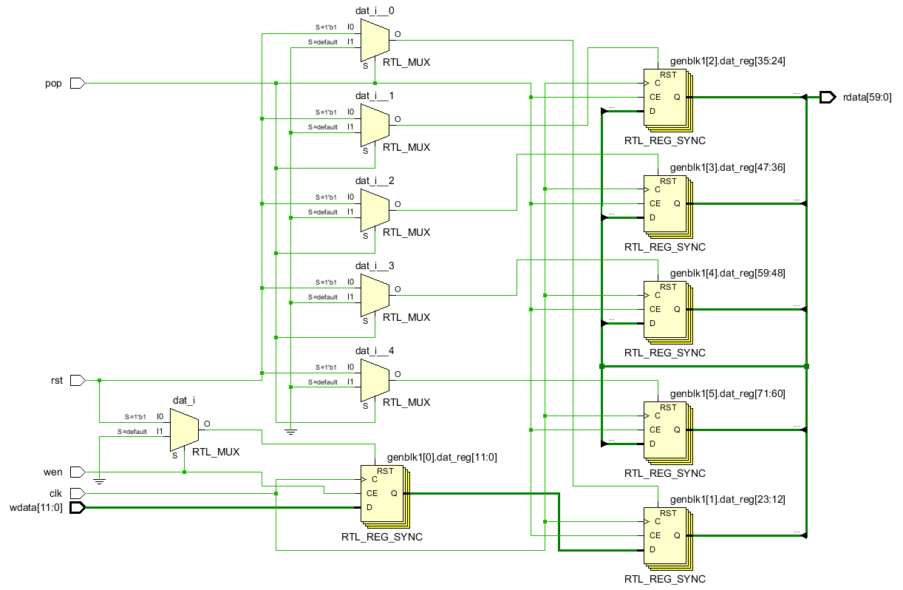
Convolution Buffer Buffer Slice

Slide 20
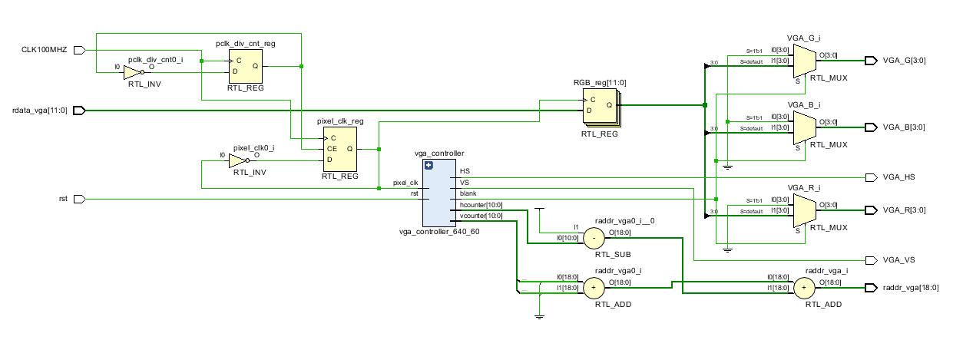
VGA Functionality

Slide 21
References
[1] Camera Datasheet: http://web.mit.edu/6.111/www/f2016/tools/OV7670_2006.pdf
[2] Camera Interface Example: https://www.fpga4student.com/2018/08/basys-3-fpga-ov7670-camera.html
[3] I2C example : https://community.element14.com/challenges-projects/interfacing-with-ov7670-camera
[4] Image Convolution Kernels: https://en.wikipedia.org/wiki/Kernel_(image_processing)

